Slide 1
Chapter 8 Mobile Computing and Commerce

Slide 2
LEARNING OBJECTIVES
Discuss the value-added attributes, benefits, and fundamental drivers of m-commerce.
Describe the mobile computing environment that supports m-commerce (devices, software, services).
Describe the four major types of wireless telecommunications networks.
Discuss m-commerce applications in finance.

Slide 3
LEARNING OBJECTIVES
Describe m-commerce applications in shopping, advertising, and provision of content.
Discuss the application of m-commerce within organizations and across the supply chain.
Describe consumer and personal applications of m-commerce.
Understand the technologies and potential application of location-based m-commerce.
Describe the major inhibitors and barriers of m-commerce.

Slide 4
MOBILE COMMERCE: ATTRIBUTES, BENEFITS, AND DRIVERS
mobile commerce (m-commerce or
m-business)
Any business activity conducted over a wireless telecommunications network or from mobile devices.

Slide 5
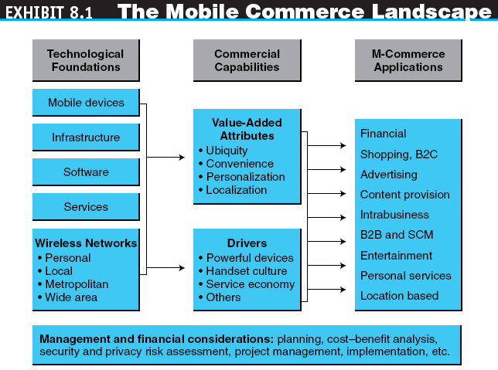

Slide 6
MOBILE COMMERCE: ATTRIBUTES, BENEFITS, AND DRIVERS
ATTRIBUTES OF M-COMMERCE
Ubiquity (無處不在)
Convenience
Interactivity
Personalization
Localization

Slide 7
MOBILE COMMERCE: ATTRIBUTES, BENEFITS, AND DRIVERS
DRIVERS OF M-COMMERCE
Widespread availability of more powerful mobile devices
The handset culture (age 15-25 group-online buyers)
The service economy/industry
Vendor’s push (via advertising their products)
The mobile workforce (e.g. sales people)
Increased mobility (work during travel time)
Improved price/performance (cheaper & cheaper)
Improving bandwidth (faster speed)

Slide 8
COMPONENTS, TECHNICAL INFRASTRUCTURE, AND SERVICES OF MOBILE COMPUTING
wireless mobile computing (mobile computing)
Computing that connects a mobile device to a network or another computing device, anytime, anywhere.

Slide 9
COMPONENTS, TECHNICAL INFRASTRUCTURE, AND SERVICES OF MOBILE COMPUTING
In the past… computer is computer, mobile phone is mobile phone, PDA is PDA
NOW…converging functionalities
MOBILE DEVICES
personal digital assistant (PDA)-eg blackberry
A stand-alone handheld computer principally used for personal information management.
smart phone
A mobile phone with PC-like capabilities.

Slide 10
COMPONENTS, TECHNICAL INFRASTRUCTURE, AND SERVICES OF MOBILE COMPUTING
MOBILE COMPUTING SOFTWARE AND SERVICES
Messaging Services
short message service (SMS) – “texting” (max 160 characters)
A service that supports the sending and receiving of short text messages on mobile phones.
multimedia messaging service (MMS)
The emerging generation of wireless messaging; MMS is able to deliver rich media.

Slide 11
COMPONENTS, TECHNICAL INFRASTRUCTURE, AND SERVICES OF MOBILE COMPUTING
Location-Based Services (via GPS)
Voice-Support Services (people talk 2.5 times faster than type)
interactive voice response (IVR)
A voice system that enables users to request and receive information and to enter and change data through a telephone to a computerized system.
voice portal (e.g. tellme.com)
A Web site with an audio interface that can be accessed through a telephone call.

Slide 12
COMPONENTS, TECHNICAL INFRASTRUCTURE, AND SERVICES OF MOBILE COMPUTING
WIRELESS TELECOMMUNICATIONS NETWORKS
personal area network (PAN)
A wireless telecommunications network for device-to-device connections within a very short range.
Bluetooth (up to 20meters distance)
A set of telecommunications standards that enables wireless devices to communicate with each other over short distances.

Slide 13
COMPONENTS, TECHNICAL INFRASTRUCTURE, AND SERVICES OF MOBILE COMPUTING
wireless local area network (WLAN)
A telecommunications network that enables users to make short-range wireless connections to the Internet or another network.
Wi-Fi (wireless fidelity)
The common name used to describe the IEEE 802.11 standard used on most WLANs.
Municipal Wi-Fi networks (connection of several hotspots to create a city-like wifi network)

Slide 14
COMPONENTS, TECHNICAL INFRASTRUCTURE, AND SERVICES OF MOBILE COMPUTING
WiMax (Worldwide Interoperability for Microwave Access)
A wireless standard (IEEE 802.16) for making broadband network connections over a medium-size area such as a city.
wireless wide area network (WWAN)
A telecommunications network that offers wireless coverage over a large geographical area, typically over a cellular phone network.

Slide 15
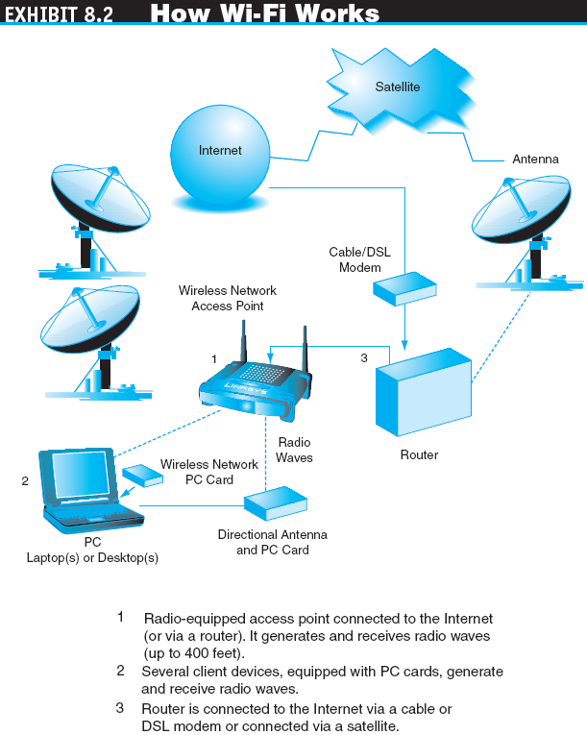

Slide 16
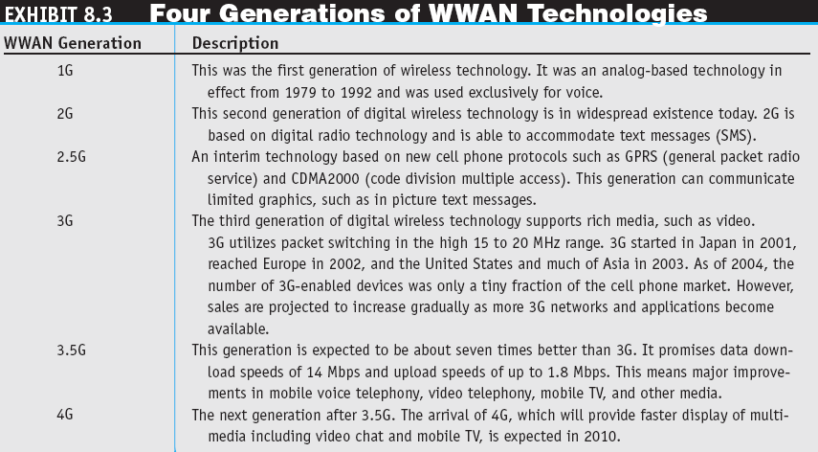

Slide 17
MOBILE FINANCIAL APPLICATIONS
MOBILE BANKING
MOBILE PAYMENTS
Mobile Proximity Payments (e.g. pay train tickets via mobile phones)
Mobile Remote Payments
microfinance
Refers to the provision of financial services to poor or low-income clients, including consumers and the self-employed.

Slide 18
MOBILE MARKETING AND ADVERTISING
MOBILE MARKETING CAMPAIGNS
Four classes of online campaigns:
Information
Entertainment
Raffles
Coupons

Slide 19
MOBILE MARKETING AND ADVERTISING
The major objectives of these classes fell into one of six categories:
Building brand awareness
Changing brand image
Promoting sales
Enhancing brand loyalty
Building customer databases
Stimulating mobile word of mouth

Slide 20
MOBILE MARKETING AND ADVERTISING
Code of Conduct (Mobile Marketing Assoc-MMA)
MOBILE MARKETING GUIDELINES
Notice (clear terms & conditions)
Choice and consent
Customization and constraint
Security (protection of user data)
Enforcement and accountability

Slide 21
MOBILE WORKFORCE SOLUTIONS
mobile worker
Any employee who is away from his or her primary work space at least 10 hours a week or 25 percent of the time.

Slide 22
MOBILE WORKFORCE SOLUTIONS
Benefits of Mobile Workforce Support
Provides mobile workers with real-time access to enterprise data and applications
Reduces time required in the field to process orders or to service customer requests
Automates existing paper and pen processes and workflows
Ensures that processes are completed in a uniform fashion with minimal data entry errors or data loss

Slide 23
MOBILE WORKFORCE SOLUTIONS
Mobile workers can be divided into three segments:
Mobile professionals (senior executives and consultants)
Mobile field force (field sales and service technicians)
Mobile specialty workers (delivery personnel and construction workers)

Slide 24
MOBILE WORKFORCE SOLUTIONS
Some of the solutions that are widely used by the three segments include:
Mobile office applications
Sales force automation (SFA) – sales process wokflow
Field force automation (FFA) – delivery & dispatch
Mobile CRM (e-CRM) – Customer Relationship Management

Slide 25
MOBILE WORKFORCE SOLUTIONS
Challenges of Mobile Workforce Support
Network coverage gaps and interruptions
Internetwork roaming
Mobile network and application performance
Device and network management
Bandwidth management

Slide 26
MOBILE ENTERTAINMENT
mobile entertainment
Any type of leisure activity that utilizes wireless telecommunication networks, interacts with service providers, and incurs a cost upon usage.

Slide 27
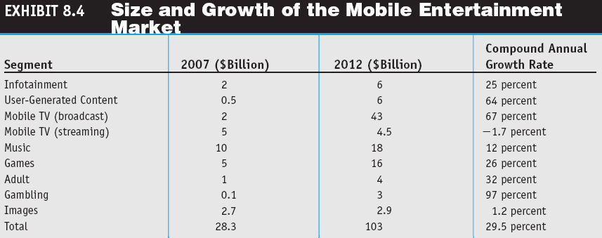

Slide 28
MOBILE ENTERTAINMENT
MOBILE MUSIC AND VIDEO
MOBILE GAMES
Technology
Number of players
Genre
MOBILE GAMBLING

Slide 29
LOCATION-BASED MOBILE COMMERCE
location-based m-commerce
(l-commerce)
Delivery of m-commerce transactions to individuals in a specific location, at a specific time.

Slide 30
LOCATION-BASED MOBILE COMMERCE
The services provided through location-based m-commerce focus on five key factors:
Location
Navigation
Tracking (person or thing like DHL)
Mapping
Timing

Slide 31
LOCATION-BASED MOBILE COMMERCE
L-COMMERCE INFRASTRUCTURE
Mobile devices
Communication network
Positioning component
Service or application provider
Data or content provider

Slide 32
LOCATION-BASED MOBILE COMMERCE
Positioning Component
network-based positioning
Relies on base stations to find the location of a mobile device sending a signal or sensed by the network.
terminal-based positioning
Calculating the location of a mobile device from signals sent by the device to base stations.

Slide 33
LOCATION-BASED MOBILE COMMERCE
global positioning system (GPS)
A worldwide satellite-based tracking system that enables users to determine their position anywhere on Earth.
real-time location system (RTLS)
Systems used to track and identify the location of objects in real time.

Slide 34
LOCATION-BASED MOBILE COMMERCE
Location-Based Data
Locating – where am I or where is the object?
Navigating – how do get there ?
Searching – where is the nearest or most relevant?
Identifying – what, who or how much?
Event checking – what happens here and there?
Geographical information system (GIS)
A computer system capable of integrating, storing, editing, analyzing, sharing, and displaying geographically referenced (spatial) information.

Slide 35
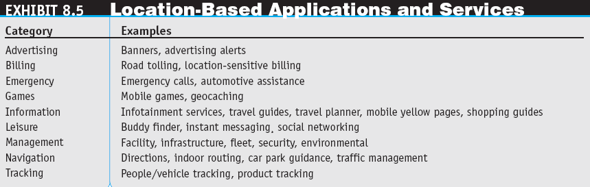

Slide 36
LOCATION-BASED MOBILE COMMERCE
Copyright © 2011 Pearson Education, Inc. Publishing as Prentice Hall
8-35
Examples:
Find empty parking spaces in a city ?
Find nearest available taxi ?
Notes:
35

Slide 37
LOCATION-BASED MOBILE COMMERCE
BARRIERS TO LOCATION-BASED
M-COMMERCE
Lack of GPS in mobile phones
Accuracy of devices (good devices accurate up to 15m)
The cost-benefit justification
Limited network bandwidth
Invasion of privacy

Slide 38
SECURITY AND OTHER IMPLEMENTATION ISSUES IN MOBILE COMMERCE
M-COMMERCE SECURITY ISSUES
The basic security goals of confidentiality, authentication, authorization, and integrity are just as important for m-commerce as they are for e-commerce but are more difficult to ensure
An appropriate level of security must be maintained on several networks, both wireless and wired.
ETHICAL, LEGAL, AND HEALTH ISSUES IN M-COMMERCE – if a company has rights to monitor company emails, do they have rights to monitor voice communication on a company-owned mobile phone?

Slide 39
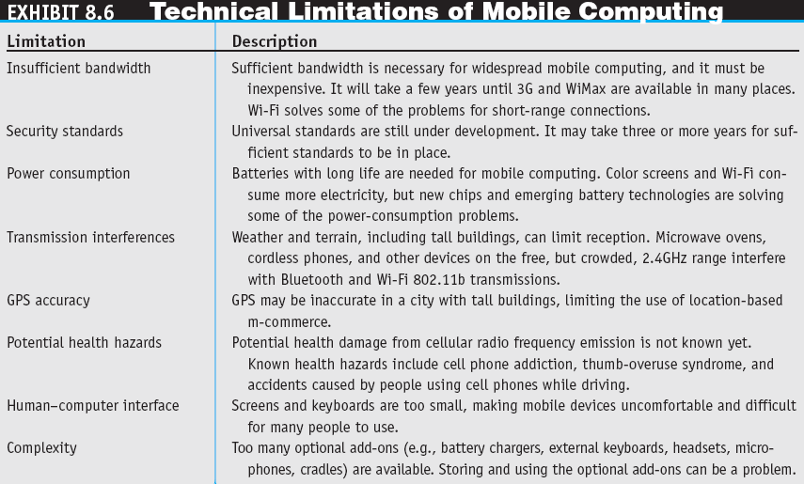

Slide 40
MANAGERIAL ISSUES
What is your m-commerce strategy?
What is your timetable?
Are there clear technical winners?
Which applications should be implemented first?

